Slide 1
Big Mountain ticket analysis

Slide 2
Problem Identification
Problem Statement: Was the increase of the operating cost for distributing visitor between different trails and charging a premium price for skiing the best business model. Is there a better price option that maximize the visitor visiting the facilities.
Context: It has yearly visitor of 350,000 for skiing and snowboarding. Was the investment in additional chair lift correct?
Criteria: Big Mountain needs to validate if their pricing is maximizing their investments. With adjustments of additional ski lifts. Big Mountain should be able accommodate an additional 10% of visitors.
Scope of the solution space
Validate if the pricing needs to be increase or decrease.
What amenities will increase ticket pricing.

Slide 3
Recommendation and key finding
The data analysis of the ticket of $81 can be increased to $95.87 due to the modeling and show the amenities will support the price increase.
Big Mountain Resort should increase their price, currently it is below the market price
With the additional to chair lift we can increase ticket price to cover the operation cost. I found that every $1.99 price increase we can add an additional $3,474,638 of revenue.* The additional chairlift would support this increase
*Found in our model 5.9.3 scenario 2 and 3

Slide 4
Recommendation and key finding cont
These are the 2 changes we can add to increase the price of the ticket
Add vertical drop
2 acre of snow making

Slide 5
Modeling
Big Mountain Adult ticket weekend is the highest in Montana.
Big Mountain is amongst the resorts with the largest amount of skiable terrain.
Big Mountain is doing well for vertical drop, but there are still quite a few resorts with a greater drop.
Big Mountain is very high up the league table of snow making area.
Most resorts have no fast quads. Big Mountain has 3, which puts it high up that league table.

Slide 6
Modeling cont.
Big Mountain and the majority of resorts have no trams.
Big Mountain has one the highest number of total chairs, very few resorts have more chairs than Big Mountain.
Compare to other resorts Big Mounting has a greater number of runs compare to the competitors.

Slide 7
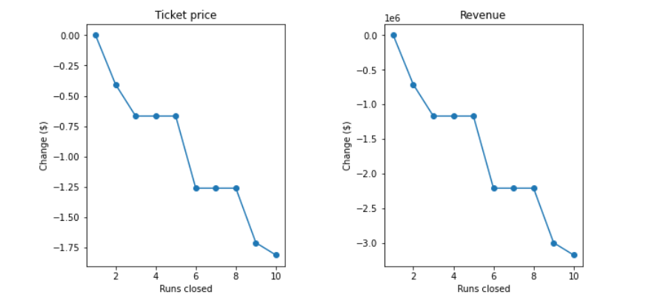
Modeling cont… Scenario model for increasing revenue
If we tried to close 10 of the least used runs it will affect the ticket price. Closing of up 5 runs or more will affect the ticket price by 1%. percenT revenue by 1%
Increasing the longest run by 0.2 mile to boast 3.5 miles length, requiring an additional snow making coverage of 4 acres but does not support an increase of ticket price.

Slide 8
Conclusion
Current price is $81.00 in Big Mountain Resort, but modelling price suggests for $95.87.
After analyzing the amenities of Big Mountain Resort and other resorts, I believe the ticket price is below market value.
The additional operating cost of chair lift would support additional revenue of $3,474,638. This will pay for the investment within 1 season.
The model suggest future investment should be done in Snow Making or in Vertical drops of 150 ft.

